Slide 1


> dotnet tour
Scott Addie
Senior Content Developer
@Scott_Addie

Slide 2
Agenda
CLI overview
Frequently used commands
VS Code integration
Scaffolding
Template creation

Slide 3




What is the .NET Core CLI?
Chassis on which tooling is built
Makes command line 1st class citizen
Works everywhere
Side-by-side installs
Multi-language support
Notes:
Installed w/ .NET Core SDK
C:\Program Files\dotnet\sdk

Slide 4


Learn abstraction below comfort zone
Visual Studio
Visual Studio Code
Visual Studio for Mac
.NET Core CLI
Notes:
Not all commands accounted for in tooling:
dotnet store (create runtime store)
Compare to GitHub for Windows vs. Git command line

Slide 5

Visual Studio
¯\_(ツ)_/¯
.NET Core CLI
(╯°□°）╯︵ ┻━┻
Notes:
“Be the mythical unicorn in a field of horses. Be the outlier with knowledge of the CLI.”

Slide 6
Command structure
dotnet command [<arguments>] [<options>]
dotnet publish my_app.csproj -c Release
Notes:
dotnet my_app.dll ← only case when dotnet is used w/o command
For running FDD app
Tab completion supported in PowerShell, Bash, & Z Shell (zsh)
See dotnet/cli repo’s Documentation/general folder

Slide 7
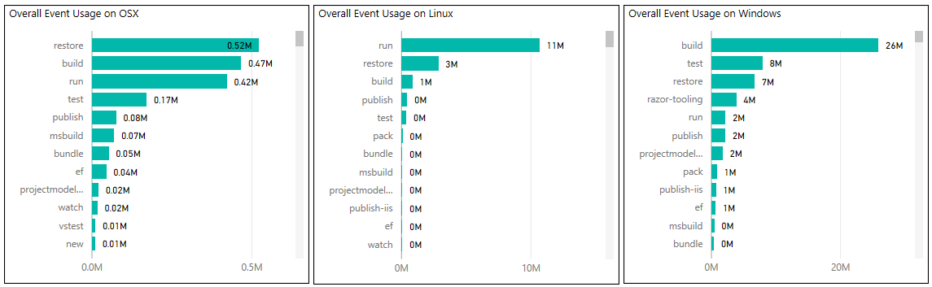
DEMO
Frequently used commands
Notes:
- gathered from telemetry in 7/2017

Slide 8
Integration with VS Code
Consistent experience on all platforms
Extensions:
C# (OmniSharp)
Azure CLI Tools
Use with…
Command Palette
Integrated Terminal
Tasks

Slide 9
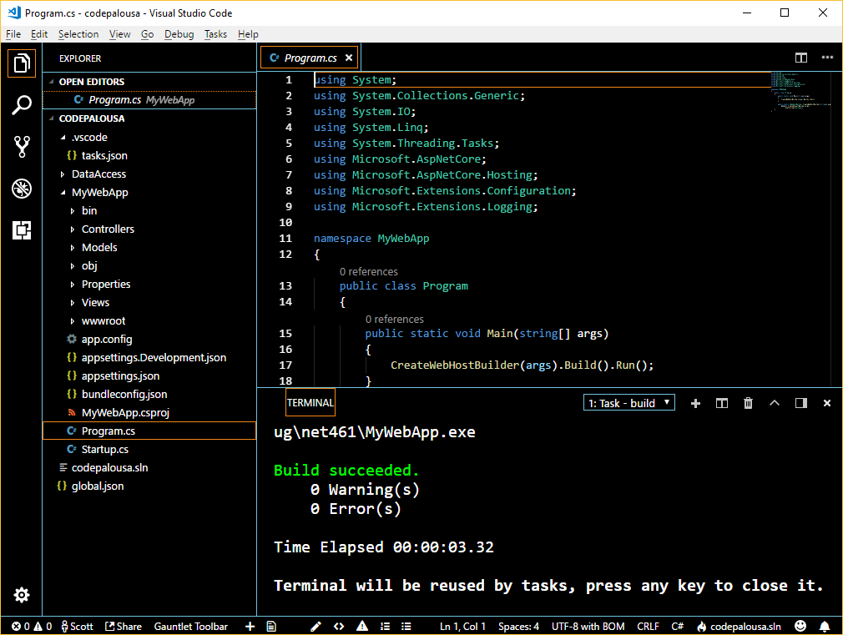

VS Code DEMO

Slide 10
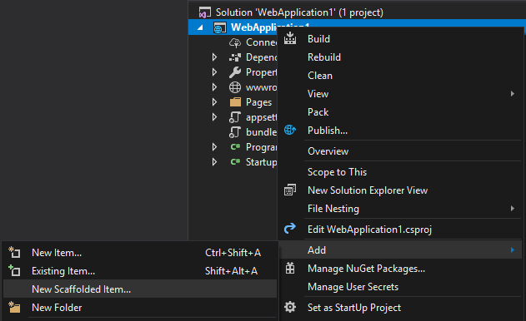
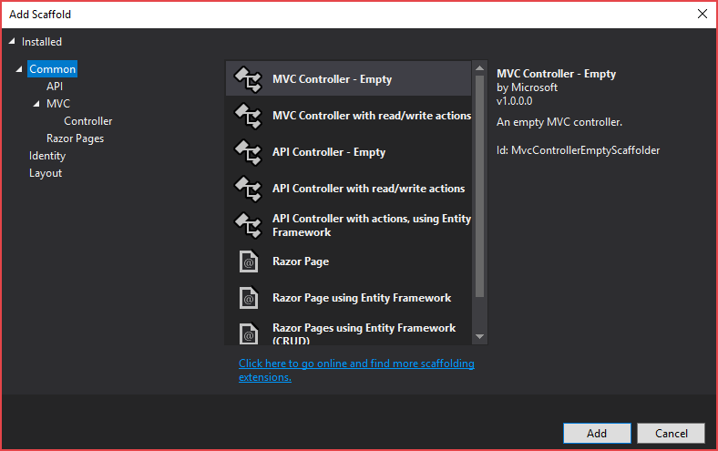
Right-click > Add > New Scaffolded Item…?

Slide 11


Slide 12
Scaffolding tool
Pre-2.1 SDK
2.1+ SDK
> dotnet tool install -g dotnet-aspnet-codegenerator --version 2.1.3
test_app.csproj
<DotNetCliToolReference Include="Microsoft.VisualStudio.Web.CodeGeneration.Tools"
Version="2.0.0" />
Notes:
Global tool replaces <DotNetCliToolReference /> w/ 2.1+ SDK

Slide 13
Scaffolding setup
C:\working_folder\test_app> dotnet aspnet-codegenerator -h Usage: aspnet-codegenerator [arguments] [options] Arguments: generator Name of the generator. Check available generators below. Options: -p|--project Path to .csproj file in the project. -n|--nuget-package-dir -c|--configuration Configuration for the project (Possible values: Debug/ Release) -tfm|--target-framework Target Framework to use. (Short folder name of the tfm. eg. net46) -b|--build-base-path --no-build Available generators: area : Generates an MVC Area. controller: Generates a controller. identity : Generates an MVC Area with controllers and razorpage : Generates RazorPage(s). view : Generates a view.
test_app.csproj
<Project Sdk="Microsoft.NET.Sdk.Web"> <PropertyGroup> <TargetFramework>netcoreapp2.1</TargetFramework> </PropertyGroup> <ItemGroup> <PackageReference Include="Microsoft.AspNetCore.App" Version="2.1.3" /> <PackageReference Include="Microsoft.VisualStudio.Web.CodeGeneration.Design" Version="2.1.3" /> </ItemGroup> </Project>
Notes:
enables item template generation

Slide 14
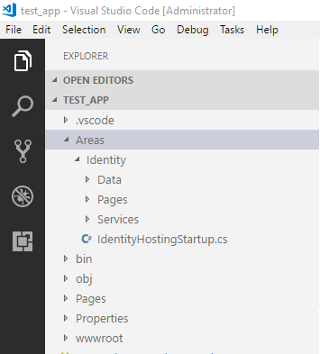

Scaffolding command
C:\working_folder\test_app> dotnet aspnet-codegenerator identity --force Building project ... Finding the generator 'identity'... Running the generator 'identity'... RunTime 00:00:15.48

Slide 15
Creation of templates
Create .template.config folder
Define metadata in template.json
Create .nuspec file
nuget pack <path_to_nuspec>
dotnet new -i <path_to_nupkg>
Notes:
works for project & item templates
NuGet steps optional if doing file system / network share installation
SideWaffle Template Creator extension for VS 2017 ← add templates to VS
github.com/schemastore

Slide 16
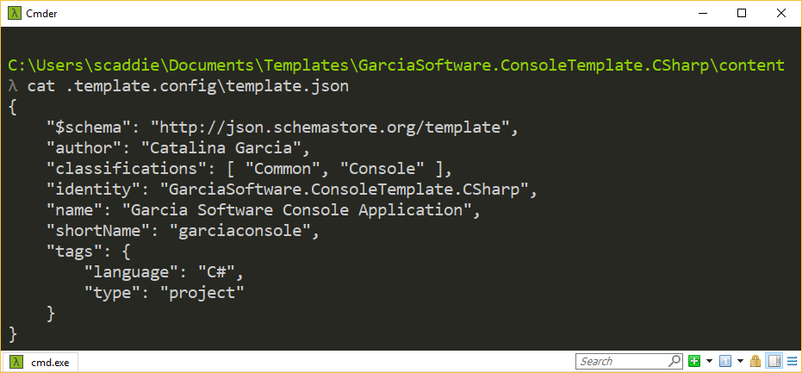
DEMO
Template creation

Slide 17




Resources
Slides:
aka.ms/dotnetcli-slides
Frequent Commands:
aka.ms/dotnetcli-cmd
Templating Commands:
aka.ms/dotnetcli-tmpl
docs.microsoft.com/dotnet/core/tools
@Scott_Addie

